Slide 1
The Evolution of C#
C# 4.0
Dynamic Programming
C# 3.0
Language Integrated Query
C# 2.0
Generics
C# 1.0
Managed Code

Slide 2
C# 4.0 Language Innovations
Dynamically Typed Objects
Optional and Named Parameters
Improved COM Interoperability
Co- and Contra-variance

Slide 3
C# Versions
Framework Version | C# Version | Features | Development Tool
1.0 | C#1 | Managed code | VS.NET
1.1 | C#1 | Managed Code | VS.NET 2003
2.0 | C#2 | Generics, Nullable Types ,Partial classes, Anonymous methods | VS.NET 2005
3.0 | C# 3 | Implicit typing, object and collection initializers, anonymous types, automatic properties, lambda expressions, | Expression Blend
3.5 | C# 3 | extension methods | VS.NET 2008
4.0 | C# 4 | dynamic typing, optional parameters, named arguments, and generic variance | VS.NET 2010
4.5 | C# 5 | Asynchronous functions, caller info attributes. | VS.NET 2012

Slide 4
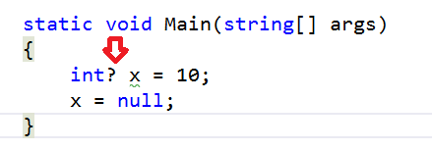
Nullable Types :
Nullable types are instances of System.Nullable<T> struct.
A nullable type can represent the correct range of values for its underlying value type, plus an additional null value.
< data_type> ? <variable_name> = null;

Slide 5
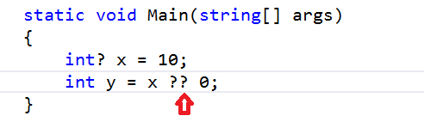
The ?? operator is called the null-coalescing operator
It returns the left-hand operand if the operand is not null
Otherwise it returns the right operand

Slide 6
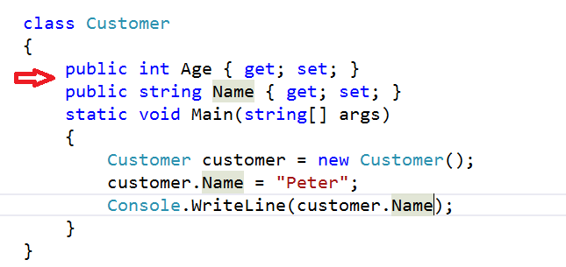
Auto-Implemented Properties
Auto-implemented properties make property-declaration more concise when no additional logic is required in the property accessors
When you declare a property the compiler creates a private, anonymous backing field that can only be accessed through the property's get and set accessors.

Slide 7
Partial Classes and Methods
It is possible to split the definition of a class or a struct, an interface or a method over two or more source files. Each source file contains a section of the type or method definition, and all parts are combined when the application is compiled.
When working with automatically generated source, code can be added to the class without having to recreate the source file.
Visual Studio uses this approach when it creates Windows Forms,
Web service wrapper code, and so on.
To split a class definition, use the partial keyword modifier.

Slide 8
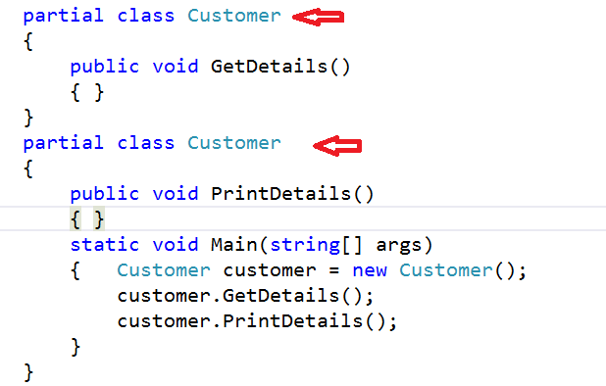
Example :Partial Class

Slide 9
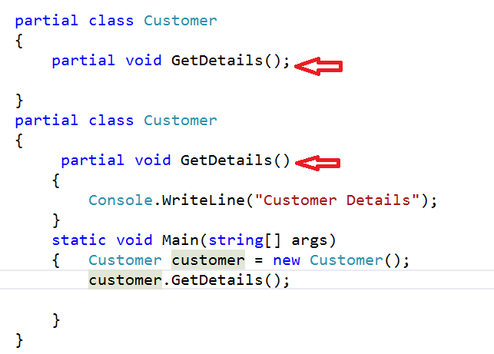
Example :Partial Method

Slide 10
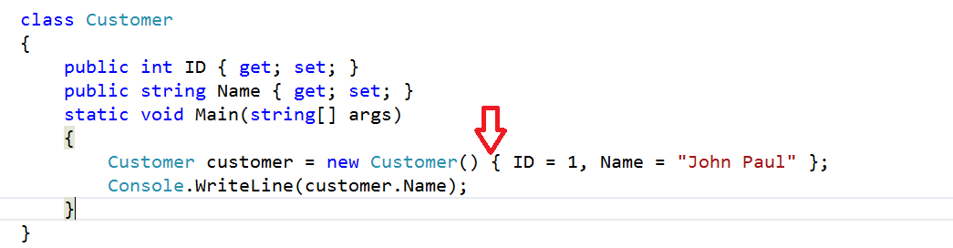
Object initializer
Object initializers let you assign values to any accessible fields or properties of an object at creation time without having to explicitly invoke a constructor.

Slide 11
Collection Initializers
Collection initializers let you specify one or more element intializers when you initialize a collection class that implements IEnumerable.
The element initializers can be a simple value, an expression or an object initializer.
By using a collection initializer you do not have to specify multiple calls to the Add method of the class in your source code; the compiler adds the calls.

Slide 12
Collections :
For the vast majority of applications, there is no need to build custom data structures.
Instead, you can use the prepackaged data-structure classes provided by the .NET Framework.
These classes are known as collection classes—they store collections of data. Each instance of one of these classes is a collection of items.
Collection classes enable programmers to store sets of items by using existing data structures, without concern for how they are implemented.
System.Collections contains collections that store references to objects.

Slide 13
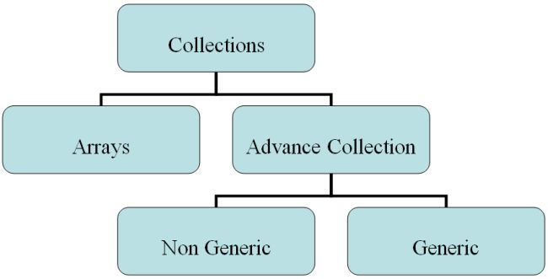
Collections (Contd.)

Slide 14
Collections (Contd.)
Non-Generic Collections : System.Collections
ArrayList
Bit Array
HashTable
Stack
Queue
Generic Collections : System.Collections.Generic
List<ItemType>
Dictionary<K,V>
Stack<ItemType>
Queue<ItemType>

Slide 15
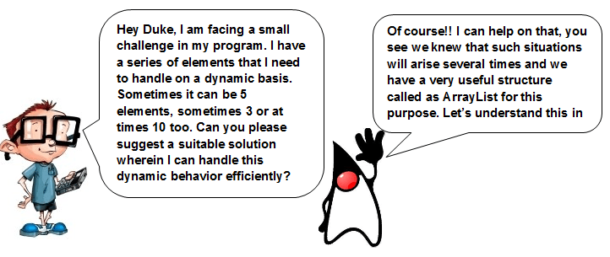

Slide 16
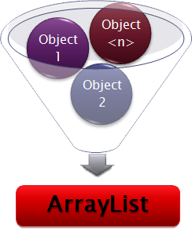
ArrayList
Limitations of traditional array
Cannot change the size or length of an array after it is created
ArrayList can set size at run time
Shrink and grow dynamically
Lower bound is 0
Holds references to objects
Need to cast whenever you take an item out of an typed array list
Includes large number of predefined methods

Slide 17
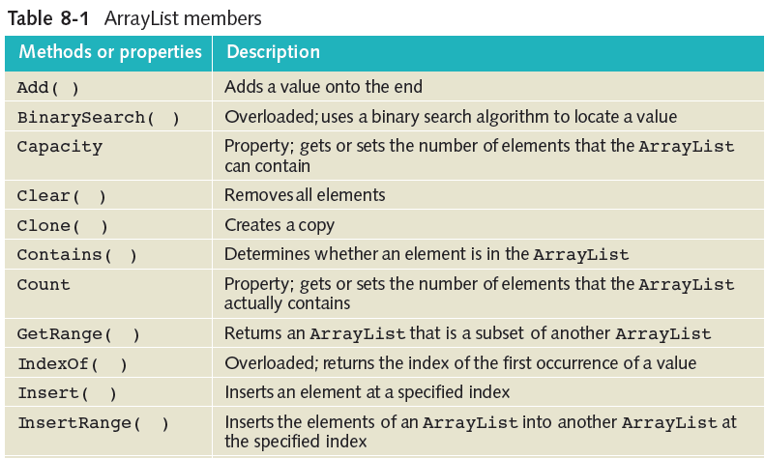
ArrayList methods and properties

Slide 18
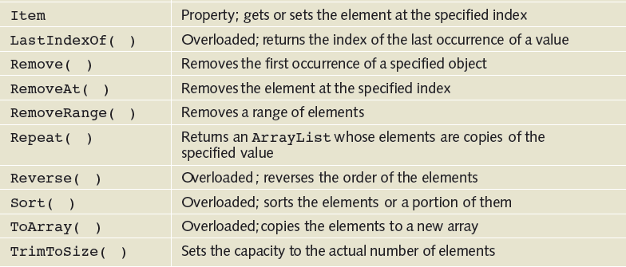
ArrayList methods and properties

Slide 19
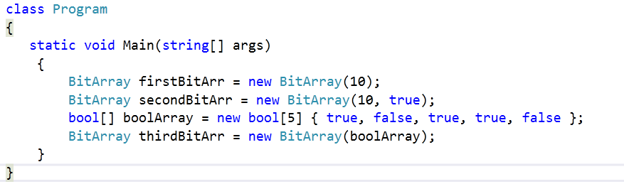
BitArray
BitArrays most commonly used to represent a simple group of Boolean flags
Bit values are represented as Booleans
BitArrays useful for working with large data sets
Properties - Count,Length,Item
Methods - Set( ) and SetAll ( )
Example:

Slide 20
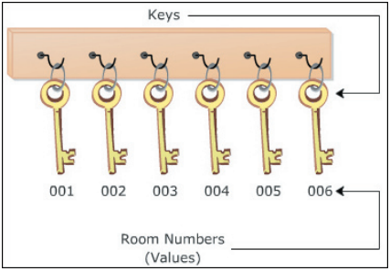
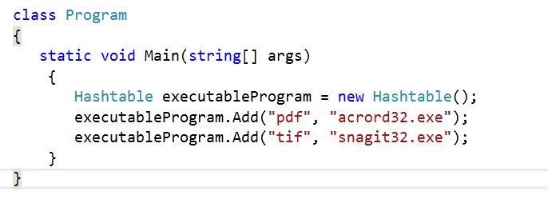
HashTable :
Hashtable represents a collection of key/value pairs that are organized based on the hash code of the key
Hash code - a number generated using a key with the objective of
providing efficient insertion and find operations
Example:

Slide 21
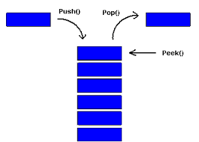
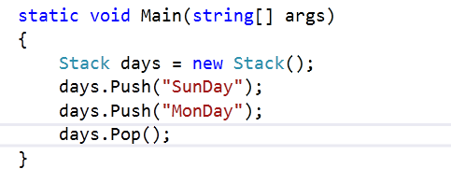
Stack
Last-in-first-out (LIFO) collection of objects
As elements are added, the capacity is automatically increased
Push( ) adds an object to the end of the stack
Pop( ) removes and returns the object to the beginning of the stack
Peak( ) returns the object at the beginning of the stack without removing it
Example:

Slide 22
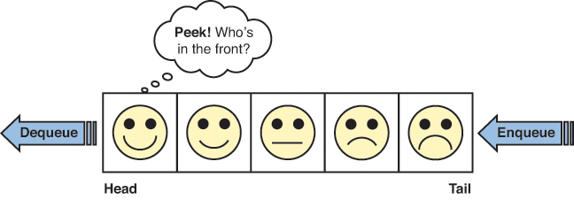
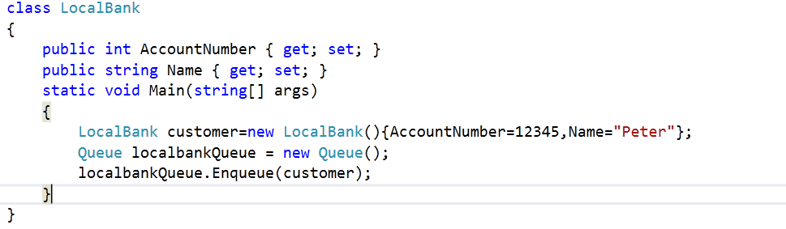
Queue
First-In-First-Out (FIFO) collection of objects
Useful for storing objects in the order they were received for sequential processing
Capacity of a queue is the number of elements the queue can hold
Enqueue( ) adds an object to the end of the queue
Dequeue( ) removes and returns object at the beginning of the queue
Example:

Slide 23
Delegates
Delegates in C# allow you to dynamically change the reference to the methods in a class.
A delegate is a reference type variable, which holds the reference to a method.
Delegates are a general-purpose mechanism for indirectly calling methods at runtime. Primary use of delegates in C# programming is for implementing events and the call-back methods.
To implement delegates in your application you need to declare delegates, instantiate delegates and use delegates.

Slide 24
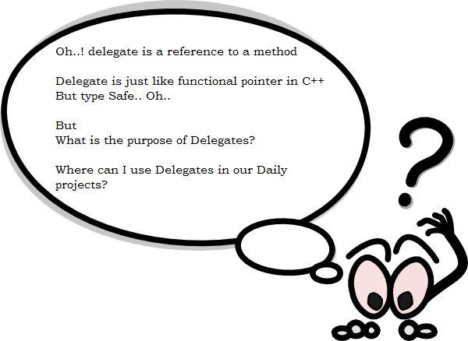
Delegates

Slide 25
Declaring Delegates
The methods that can be referenced by a delegate are determined by the delegate declaration.
The delegate can refer to the methods, which have the same signature as that of the delegate.
delegate declaration:
delegate<return type><delegate-name>(<parameter list>)

Slide 26
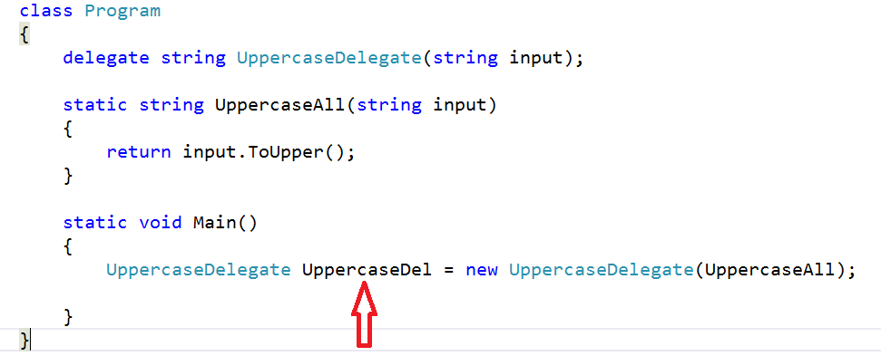
Instantiating Delegates
Assign the address of the required method to the delegate object.
This can be done by calling the constructor of the delegate class and passing the method name.

Slide 27
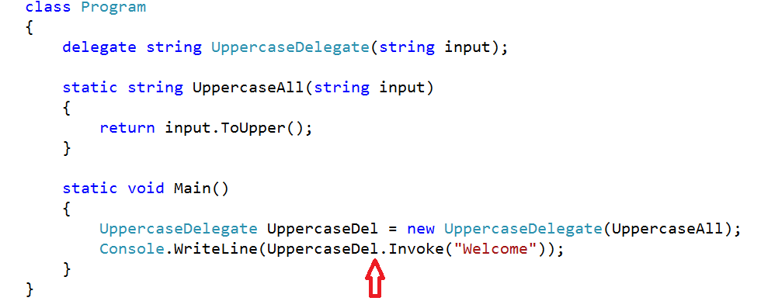
Invoking Delegate
You can call the delegate by giving the name of the delegate and by passing parameters, if required.
Using delegates is similar to calling methods.

Slide 28
Types of Delegates
There are two types of delegates:
Single-cast delegate
Multicast delegate
Single Cast Delegates:
A single-cast delegate derives from the System.Delegate class.
It contains reference to one method only at a time.
Method()
Delegate

Slide 29
Multicast Delegates(Contd.)
A multicast delegate derives from the System.MulticastDelegate class.
Method()
Method()
Method()
Multicast Delegate

Slide 30
Multicast Delegates(Contd.)
It contains an invocation list of multiple methods. In multicasting you create a single delegate that invokes multiple encapsulated methods.
You need to ensure the return type of all these delegates is same.
Multicast delegates hold the reference of more than one method therefore, if you call a multicast delegate it will executes all the methods it wraps in the calling order.

Slide 31
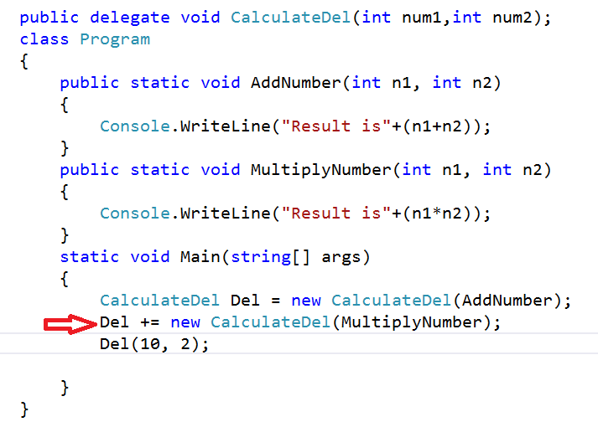
Example:

Slide 32
Working with Events
An event is an action or occurrence, such as clicks, key presses, mouse movements, or system generated notifications.
Applications can respond to events when they occur.
Clock Shows time.
Time is 6 AM.
Alarm plays a sound, notifying
everyone that it is 6 AM.
You hear the alarm.
You get up and get ready
For your school.

Slide 33
Using Delegates with events
The events are declared and raised in a class and associated with the event handlers using delegates within the same class or other classes.
Events are part of a class and the same class is used to publish its events.
The other classes can, however, accept these events or in other words can subscribe to these events.

Slide 34
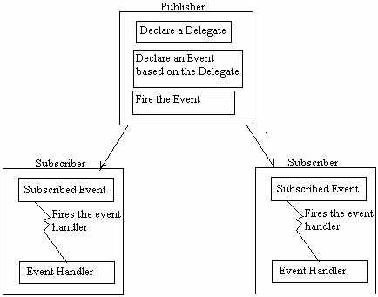
Events use the publisher and subscriber model.
A publisher is an object that contains the definition of the event and the delegate. The association of the event with the delegate is also specified in the publisher class.
A subscriber is an object that wants to accept the event and provide a handler to the event. The delegate of the publisher class invokes the method of the subscriber class.

Slide 35
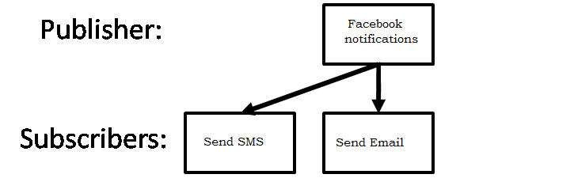
Events use the publisher and subscriber model.

Slide 36

Delegates with Events
The implementation of an event includes:
Events definition
Events subscription
Events notification
Defining an Event:
The following code defines a delegate named TimeToRise and an event named RingAlarm, which invokes the TimeToRise delegate when it is raised:
The implementation of an event includes:
Events definition
Events subscription
Events notification

Slide 37

Delegates with Events
Subscribing to an Event:
The event of the publisher class needs to be associated with its handler.
The event handler method is associated with the event using the delegate.
When the publisher object raises the event, the subscribing object associates the method, which needs to be called.
The requirement could be implemented using events. The following code shows how the Student class subscribes to the event named TimeToRise:

Slide 38
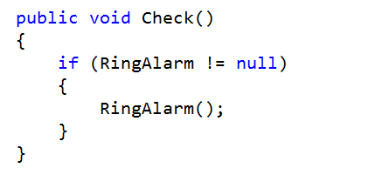
Delegates with Events
Notifying Subscribers to an Event:
The subscriber object notifies the subscriber object to the publisher object. The event is raised to notify the handler.
Write this block of code at a place from where you want to notify the event to the subscribers of the event:

Slide 39
Passing Event parameters
Parameters for events should be passed as EventArgs
Define a class descended from EventArgs to act as a container for event parameters
The same subscribing method may be called by several events
Always pass the event publisher (sender) as the first parameter to the method

Slide 40
Generics
Generics are the most powerful feature of C# 2.0.
It helps you to maximize code reuse, type safety, and performance.
The most common use of generics is to create collection classes.
The .NET Framework class library contains several new generic collection classes in the System.Collections.Generic namespace
You can create your own generic interfaces, classes, methods, events and delegates.
Reference:
https://msdn.microsoft.com/en-us/library/System.Collections.Generic(v=vs.110).aspx

Slide 41
Generic Collections
Problems with Nongeneric Collections
Having to store data as object references causes less efficient code due to unboxing.
Generic Collections
The .NET Framework also includes the System.Collections.Generic namespace, which uses C#’s generics capabilities.
Many of these new classes are simply generic counterparts of the classes in namespace System.Collections.
Generic collections eliminate the need for explicit type casts that improves type safety and efficiency.
Generic collections are especially useful for storing structs, since they eliminate the overhead of boxing and unboxing

Slide 42
Generic Collections
List<ItemType>
Dictionary<K,V>
Stack<ItemType>
Queue<ItemType>

Slide 43
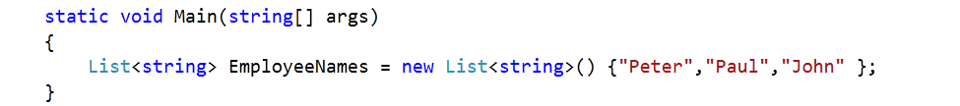
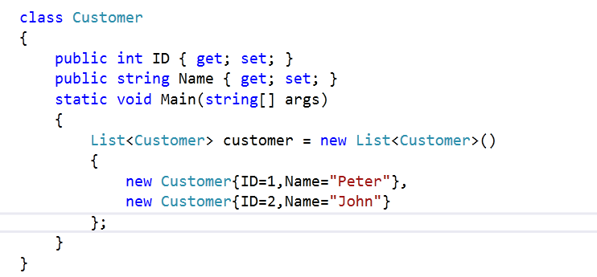
List<ItemType>
The List<T> is a generic collection that represents a strongly typed list of objects that can be accessed by index. It is just like the non-generic collection ArrayList.
Example:

Slide 44
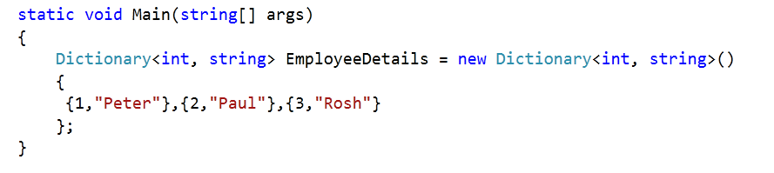
Dictionary<K,V> :
Dictionary<K, V> is a generic collection that contains data in Key/Value pairs, it is just like the non-generic collection Hashtable.
Example:

Slide 45
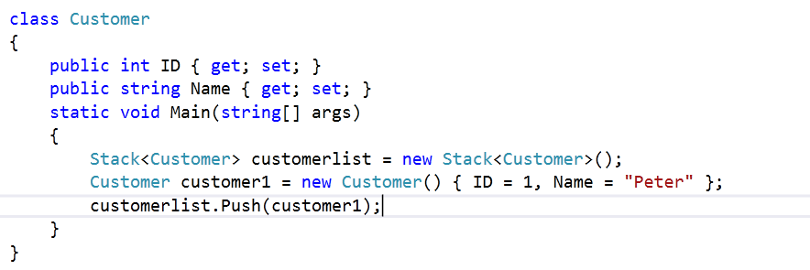
Stack<ItemType>
Stack<T> is a generic collection that represents a last-in-first-out (LIFO)
collection of instances of the same arbitrary type. It is just like the non-generic collection Stack.

Slide 46
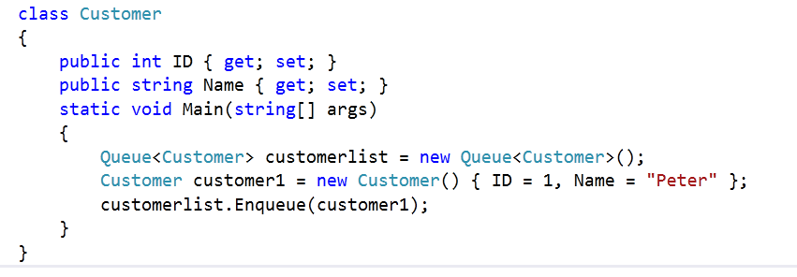
Queue<ItemType>
Queue<T> is a generic collection that represents a first-in, first-out (FIFO) collection of objects. It is just like the non-generic collection Queue.
Example:

Slide 47
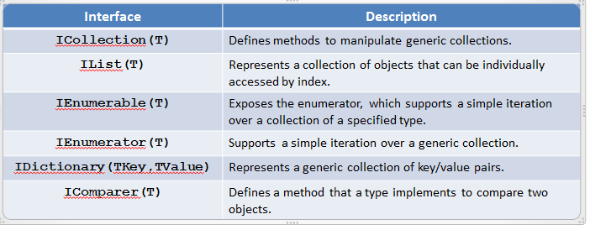
Generic Collection Interfaces
Demo

Slide 48
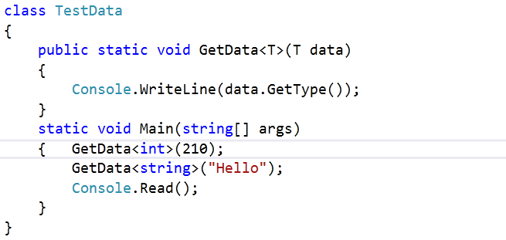
Generic Methods:
A generic method is a method that is declared with type parameters
Non-Generic class with generic method:

Slide 49
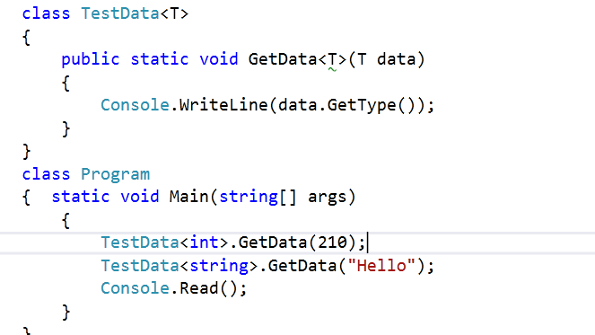
Generic class with generic method:

Slide 50
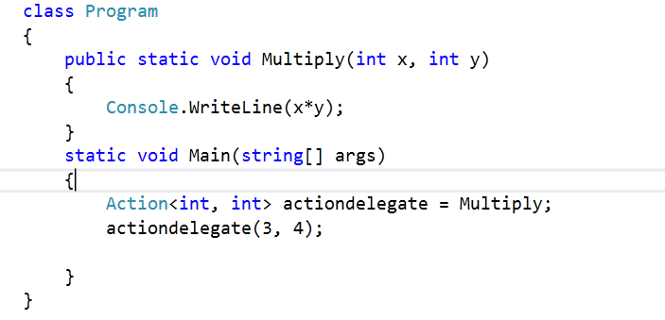
Generic Delegates:
Action
The Generic Action<> delegate is defined in the System namespace of microlib.dll
This Action<> generic delegate, points to a method that takes up to 16 Parameters and returns void.
Example 1 : Action delegate with named method

Slide 51
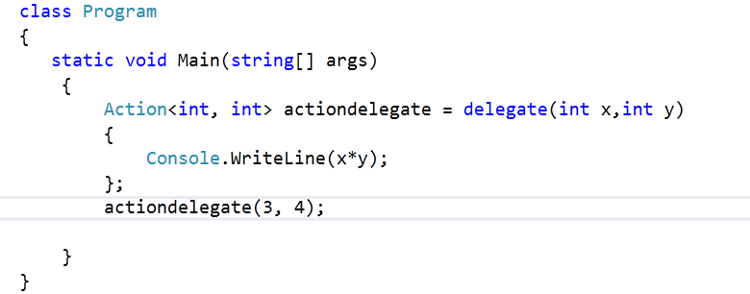
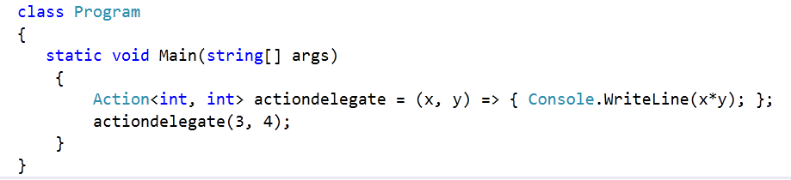
Example 2: Action delegate with Anonymous method
Example 3: Action delegate with lambda expressions

Slide 52
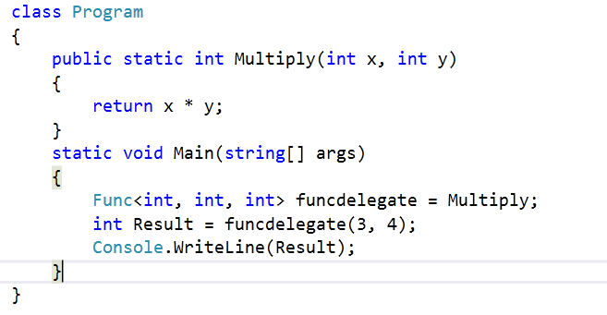
Func<T>
The generic Func<> delegate is used when we want to point to a method that returns a value.
This delegate can point to a method that takes up to 16 Parameters and returns a value.
The final parameter of Func<> is always the return value of the method.
Example 1: Func<> delegate with Named method

Slide 53
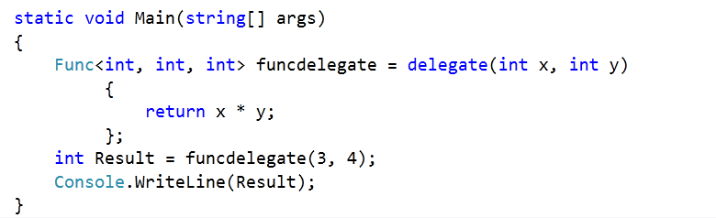
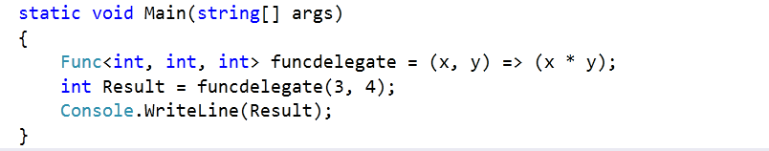
Example 2: Func<> delegate with Anonymous method
Example 3: Func<> delegate with lambda expressions

Slide 54
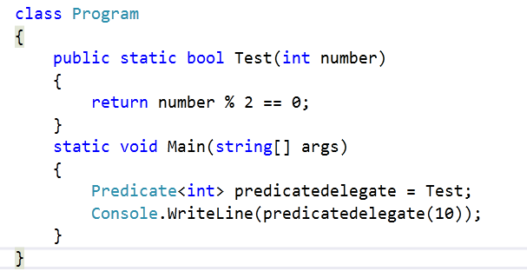
Predicate<T>
Represents the method that defines a set of criteria and determines whether the specified object meets those criteria.
This delegate is used by several methods of the Array and List<T> classes to search for elements in the collection.
Predicate is used by the following extension methods :- Exists, Find, FindAll, FindIndex, FindIndex, FindLast, FindLastIndex, RemoveAll, TrueForAll.
Example 1: Predicate<> delegate with named method

Slide 55
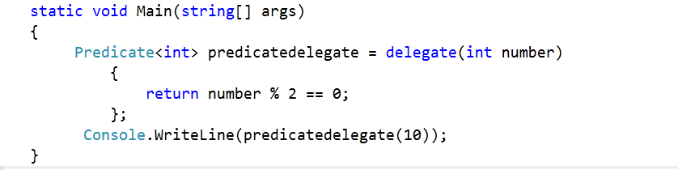
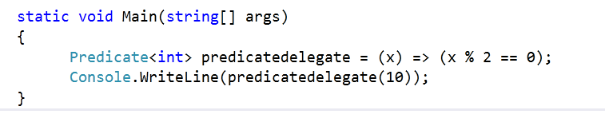
Example 2: Predicate<> delegate with Anonymous method
Example 3: Predicate<> delegate with lambda expressions

Slide 56
Constraints on Type Parameters
When you define a generic class, you can apply restrictions to the kinds of types that client code can use for type arguments when it instantiates your class
These restrictions are called constraints. Constraints are specified by using the where contextual keyword.

Slide 57
Constraints on Type Parameters
Constraint | Description
where T: struct | The type argument must be a value type. Any value type except Nullable can be specified.
where T : class | The type argument must be a reference type; This applies also to any class, interface, delegate, or array type.
where T : new() | The type argument must have a public parameter less constructor. When used together with other constraints, the new() constraint must be specified last.
where T : <base class name> | The type argument must be or derive from the specified base class.
where T : <interface name> | The type argument must be or implement the specified interface. Multiple interface constraints can be specified. The constraining interface can also be generic.
where T : U | The type argument supplied for T must be or derive from the argument supplied for U.

Slide 58
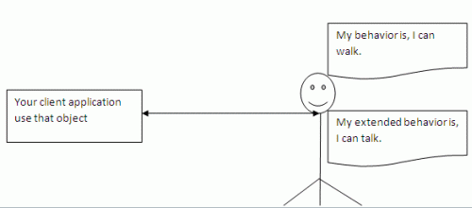
Extension Methods
Once a type is defined and compiled into an assembly its definition is,more or less,final
The only way to update, remove or add new members is to recode and recompile the code
Extension methods allow existing compiled types to gain new functionality
Without recompilation
Without touching the original assembly

Slide 59
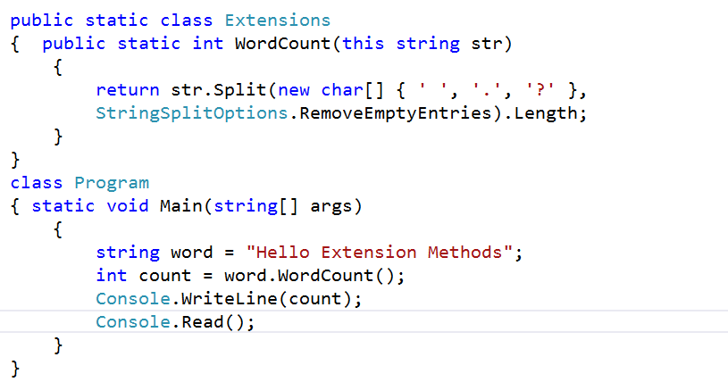
Defining Extension Methods Defined in a static class. Defined as static. Use this keyword before its first argument to specify the class
to be extended.

Slide 60

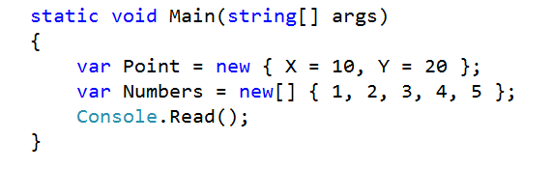
Anonymous Types :
Anonymous types are reference types directly derived from System.Object
Encapsulate a set of read-only properties and their value into single object
No need to explicitly define a type first
To define Anonymous type
Use of the new var keyword in conjuction with the object initialization syntax

Slide 61
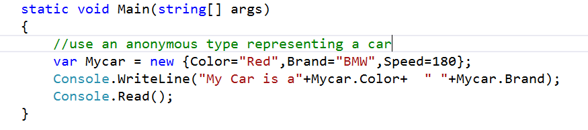
At compile time, the C# compiler will auto generate an uniquely named class
The class name is not visible from c#
Using implicitly typed (var keyword ) is mandatory

Slide 62
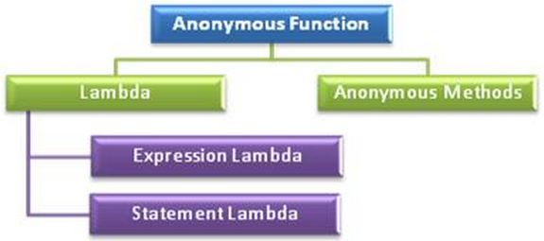
Anonymous Functions
An anonymous function is an "inline" statement or expression that can be used wherever a delegate type is expected.
You can use it to initialize a named delegate or pass it instead of a named delegate type as a method parameter.
There are two kinds of anonymous functions

Slide 63
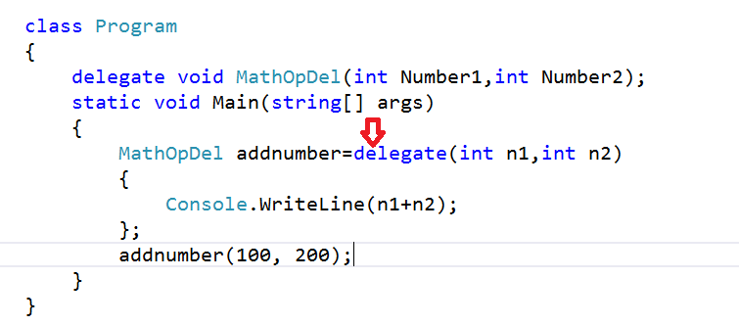
Anonymous Method
Anonymous methods are the methods without a name, just the body.
provide a technique to pass a code block as a delegate parameter.
Anonymous methods are declared with the creation of the delegate instance, with adelegate keyword

Slide 64

Lambda Expressions
A lambda expression is an anonymous function containing expressions and statements
Used to create delegate or expression tree types
All lambda expressions use the lambda operator =>, Which is read as “goes to” .
The left side of the lambda operator specifies the input parameters
The right side holds the expression or statement

Slide 65
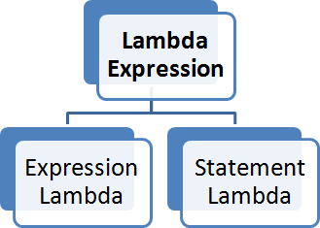
Statement Lambda
Statement lambda has a statement block on the right side of the lambda operator "=>".
x => { return x * x; };
Expression Lambda
Expression lambda has only an expression (no return statement or curly braces), on the right side of the lambda operator "=>".
x => x * x; // here x*x is expression

Slide 66
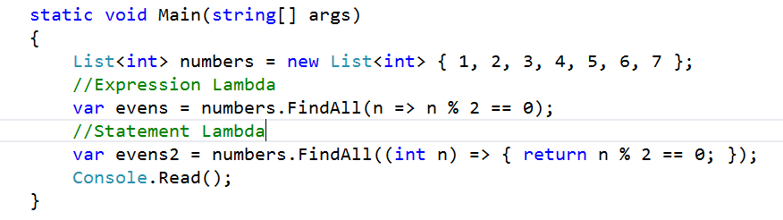

Example 1 :
Example 2 :

Slide 67
What’s New?
Dynamically Typed Objects
Optional and Named Parameter
Improved COM Interoperability
Co- and Contra-variance

Slide 68





.NET Dynamic Programming
IronPython
IronRuby
C#
VB.NET
Others…
Dynamic Language Runtime
Expression Trees
Dynamic Dispatch
Call Site Caching
Object Binder
JavaScript Binder
Python Binder
Ruby Binder
COM Binder

Slide 69
Dynamically Typed Objects
Compile-time type dynamic
Run-time type System.Int32
dynamic x = 1;
dynamic y = "Hello";
dynamic z = new List<int> { 1, 2, 3 };
When operand(s) are dynamic…
Member selection deferred to run-time
At run-time, actual type(s) substituted for dynamic
Static result type of operation is dynamic

Slide 70
Object | Dynamic | Var
Can store any kind of value, because object is the base class of all type in .NET framework. | Can store any type of the variable, similar to old VB language variable. | Can store any type of value but it require to initialize at the time of declaration.
Compiler has little information about the type | Compiler doesn't have any information about the type of variable. | Its compiler safe i.e. compiler has all information about the stored value, so that it doesn't cause any issue at run-time.
Object type can be passed as function argument and function also can return object type | Dynamic type can be passed as function argument and function also can return object type | Var type cannot be passed as function argument and function cannot return object type. This type of variable can work in the scope where it defined.
Require to cast object variable to original type before using it. | Casting is not required. | No need to cast because compiler has all information to perform operation.
Useful when doesn't have more information about the data type. | Useful when coding using reflection or dynamic language support or with the COM objects, because we require to write less amount of code. | Useful when getting result out of the linq queries. In 3.5 frameworks it introduces to support linq feature.

Slide 71

Named and Optional Arguments
Named arguments: pass parameters by name rather than position
optional parameters: allow us to omit parameters which have a defined default value.
Example: Optional Parameter

Slide 72

Example : Named Parameter

Slide 73
Variance in C# 4.0
Supported for interface and delegate types
“Statically checked definition-site variance”
Value types are always invariant
IEnumerable<int> is not IEnumerable<object>
Similar to existing rules for arrays
ref and out parameters need invariant type

Slide 74
Concept Of Variance
If y is derived from X and y relates to X, then we can assign X to y. Like X=y. This is Covariance.
If Y is derived from X and y relates to X, then we can assign y to X. Like y = X. This is Contra-variance.
If class A is related to B, then B is related to A.

Slide 75
Variance in .NET Framework 4.0
Interfaces
System.Collections.Generic.IEnumerable<out T>
System.Collections.Generic.IEnumerator<out T>
System.Linq.IQueryable<out T>
System.Collections.Generic.IComparer<in T>
System.Collections.Generic.IEqualityComparer<in T>
System.IComparable<in T>
Delegates
System.Func<in T, …, out R>
System.Action<in T, …>
System.Predicate<in T>
System.Comparison<in T>
System.EventHandler<in T>

Slide 76
Co- and Contra-variance
.NET arrays are co-variant
string[] strings = GetStringArray();
Process(strings);
void Process(object[] objects) { … }
…but not safely co-variant
void Process(object[] objects) {
objects[0] = "Hello"; // Ok
objects[1] = new Button(); // Exception!
}
Until now, C# generics have been invariant
List<string> strings = GetStringList();
Process(strings);
C# 4.0 supports safe co- and contra-variance
void Process(IEnumerable<object> objects) { … }
void Process(IEnumerable<object> objects) {
// IEnumerable<T> is read-only and
// therefore safely co-variant
}

Slide 77
Safe Co- and Contra-variance
public interface IEnumerable<T>
{
IEnumerator<T> GetEnumerator();
}
public interface IEnumerable<out T>
{
IEnumerator<T> GetEnumerator();
}
out = Co-variant Output positions only
Can be treated as less derived
public interface IEnumerator<T>
{
T Current { get; }
bool MoveNext();
}
public interface IEnumerator<out T>
{
T Current { get; }
bool MoveNext();
}
IEnumerable<string> strings = GetStrings();
IEnumerable<object> objects = strings;
in = Contra-variant Input positions only
public interface IComparer<T>
{
int Compare(T x, T y);
}
public interface IComparer<in T>
{
int Compare(T x, T y);
}
Can be treated as more derived
IComparer<object> objComp = GetComparer();
IComparer<string> strComp = objComp;

Slide 78


Co-Variance Example :
Contra-Variance Example :

Slide 79

Improved COM Interoperability
Automatic object → dynamic mapping
Optional and named parameters
Indexed properties
Optional “ref” modifier
Interop type embedding (“No PIA”)

Slide 80
Improved COM Interoperability
object fileName = "Test.docx";
object missing = System.Reflection.Missing.Value;
doc.SaveAs(ref fileName,
ref missing, ref missing, ref missing,
ref missing, ref missing, ref missing,
ref missing, ref missing, ref missing,
ref missing, ref missing, ref missing,
ref missing, ref missing, ref missing);
doc.SaveAs("Test.docx");

